Slide 1
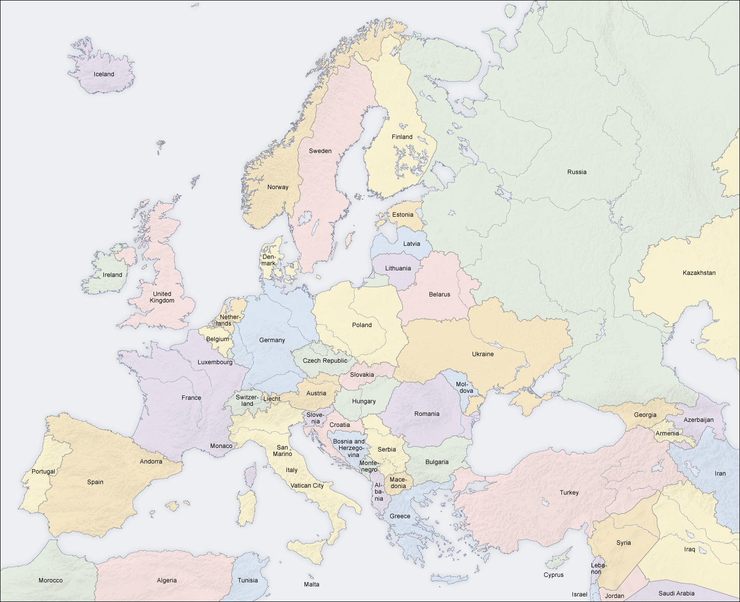
Europe
I Remember the Past
Greece
Tone Color – Instruments

Slide 2
Europe
Maid on the Shore
Ireland
Form – Strophic – Repeated melody, different lyrics

Slide 3
Europe
Diri Diri So Kerdjan
Hungary
Tone Color – string instruments used percussively

Slide 4
Europe
Think of One
Belgium
Form - Strophic

Slide 5
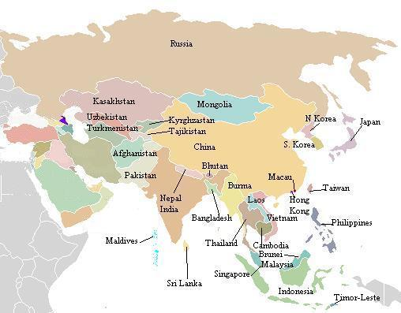
Asia
Codru (inspired by Russian Forests)
Russia
Melody – Ostinato

Slide 6
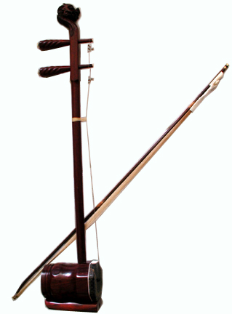
Asia
Picking Flowers
China
Tone Color - Erhu

Slide 7
Asia
Utuwaskarap
Japan
Tone Color – Tonkori

Slide 8
Asia
Afshari
Iran
Rhythm – Drums!

Slide 9
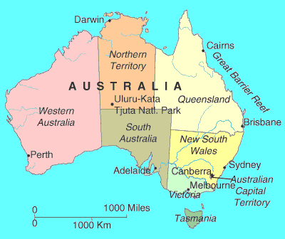
Australia
Siasi (man leaving a woman behind)
Papua New Guinea
Rhythm – strumming pattern

Slide 10
Australia
Waltzing Matilda
Australia – Sydney
Rhythm – Drums

Slide 11
Australia
Milya
Australia – Northern Territory
Tone Color – didgeridoo

Slide 12
Australia
Sei Ma Le Losa
New Zealand
Harmony – Homophony

Slide 13
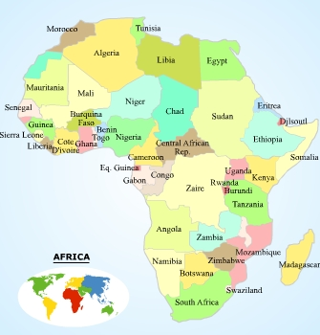
Africa
Lisanga
Congo
Rhythm-Instruments and Voices

Slide 14
Africa
Mayihlome (AIDS/HIV)
South Africa
Harmony-Voices Sing in Homophony

Slide 15
Africa
Abiani (People)
Ivory Coast
Rhythm – Instruments and Voices

Slide 16
Africa
Retany (Tale of a man trying to convince a woman to marry him)
Madagascar
Rhythm – Drums and Strings

Slide 17
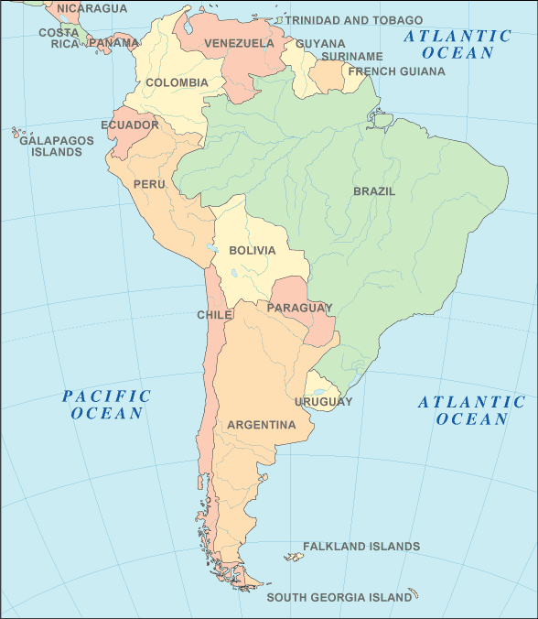
South America
Sabia (Come on Hear Me)
Brazil
Rhythm (in the guitar)

Slide 18
South America
Maria Lando
Peru
Tempo – easy going, walking pace

Slide 19
South America
Soltarlo
Colombia
Harmony – Polyphonic - acappella

Slide 20
South America
Baba
Argentina
Rhythm – changing time signatures

Slide 21
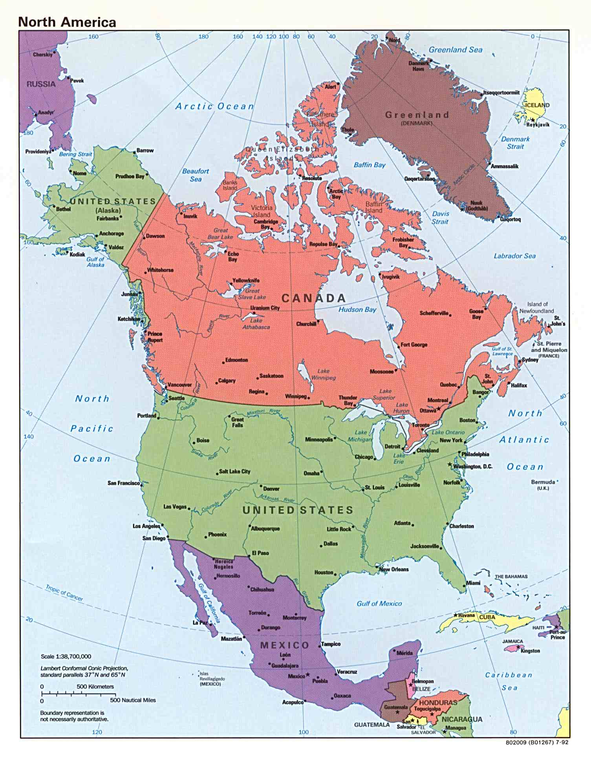
North America
Ma Peau
Canada
Rhythm – R&B

Slide 22
North America
It’s Your Voodoo Working
USA – Louisiana
Harmony – I-IV-V7

Slide 23
North America
Ozomatli
Mexico
Tone Color – Instruments

Slide 24
North America
Pallin’ with Al
USA – North Carolina
Rhythm – swing

