Slide 1
Moot – Week 1
Theme – Percussive Motif
The composer creates music that changes very slightly over time and uses percussion instruments heavily

Slide 2
Theme – Percussive Minimalism
The composer creates music that changes very slightly over time and uses percussion instruments heavily
Soundtrack Music
Knife in the Dark from The Lord of the Rings by Howard Shore
Music repeats itself with the same theme
The use of timpani, gong and cymbals create
the suspense within the storyline

Slide 3
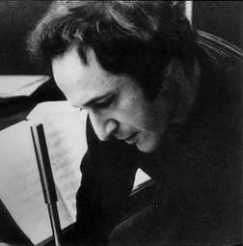
Theme – Percussive Minimalism
The composer creates music that changes very slightly over time and uses percussion instruments heavily
Art Music
Music for 18 Musicians by Steven Reich
Very short repeated music
All percussion
60 minute piece that changes every few measures

Slide 4
Theme – Percussive Minimalism
The composer creates music that changes very slightly over time and uses percussion instruments heavily
Pop Music
Fresh Prince of BelAir by Will Smith
Rap music
Uses electronic music (drum kits)
that repeat short “riffs”

Slide 5
Moot – Week 2
Theme – Theme
The composer creates a melody or idea and uses it throughout the entire piece of music

Slide 6
Theme – Theme
The composer creates a melody or idea and uses it throughout the entire piece of music
Soundtrack Music
Star Wars Music by John Williams
Each character has his/her
own theme music
Understand the mood of the character
from the music

Slide 7
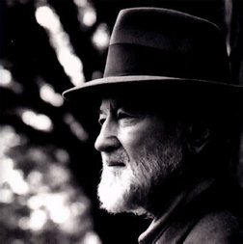
Theme – Theme
The composer creates a melody or idea and uses it throughout the entire piece of music
Art Music
Variations on “America” by Charles Ives
Patriotic songs pulled together
creating a mood for the 4th of July

Slide 8
Theme – Theme
The composer creates a melody or idea and uses it throughout the entire piece of music
Pop Music
Hey There Delilah – Plain White T’s
Everything in the song has to do with a girl, Delilah
Lyrics
Title
Feel (it’s a love song!)

Slide 9
Moot – Week 3
Theme – Tone Color
The composer can evoke a certain mood or emotion by using an instrument in a certain way or in a particular combination of instruments, utilizing the instruments in a unique register

Slide 10
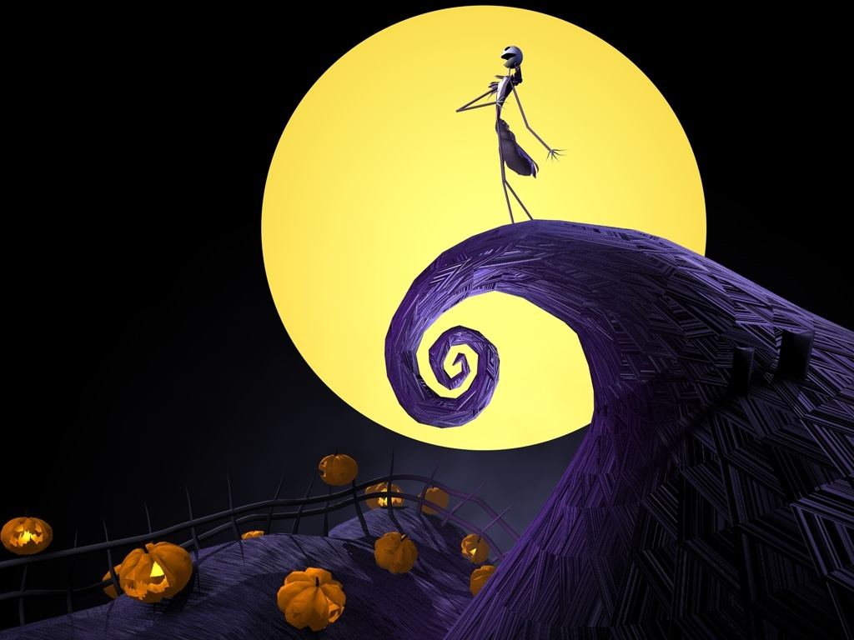
Theme – Tone Color
The composer can evoke a certain mood or emotion by using an instrument in a certain way or in a particular combination of instruments, utilizing the instruments in a unique register
Soundtrack Music
Nightmare Before Christmas Music
by Danny Elfman
Character voices
Uses instruments in a unique fashion to create a particularly spooky mood

Slide 11
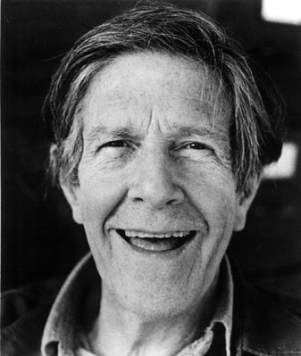
Theme – Tone Color
The composer can evoke a certain mood or emotion by using an instrument in a certain way or in a particular combination of instruments, utilizing the instruments in a unique register
Art Music
4’33”
Perilous Night
by John Cage
4’33”
4 minutes and 33 seconds = time in rests
Perilous Night
Prepared Piano
Nuts and bolts in piano

Slide 12
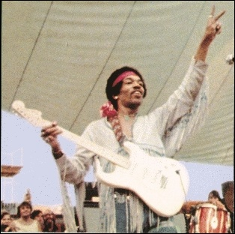
Theme – Tone Color
The composer can evoke a certain mood or emotion by using an instrument in a certain way or in a particular combination of instruments, utilizing the instruments in a unique register
Pop Music
Star Spangled Banner by Jimi Hendrix
Created a unique sound for the guitar
Music or noise?
American or non-American?

Slide 13
MOOT – Week 4
Theme – Culture The composer uses influences of another non-western culture to influence his or her musical style

Slide 14
Theme – Culture The composer uses influences of another non-western culture to influence his or her musical style
Soundtrack Music
Music from “Avatar” by James Horner
“Akkadian Empire”
Music has influence from Finland and Indonesia
Creates a sound for both human and indigenous people

Slide 15
Theme – Culture The composer uses influences of another non-western culture to influence his or her musical style
Art Music
Turangalila Symphonie: Movement 1 by Olivier Messiaen
Messiaen's symphony, which is also a non-symphony, is dissonant and tonal, brutal and lyrical, formal and sensual. Its sonic tapestries evoke India, Indonesia, and Walt Disney. Its rhythms derive from ancient Hindu practice.
National Symphony Orchestra: Christoph Eschenbach, conductor / Messiaen's Turangalîla-Symphonie
Mar. 10 - 12, 2011 © Joseph Horowitz

Slide 16
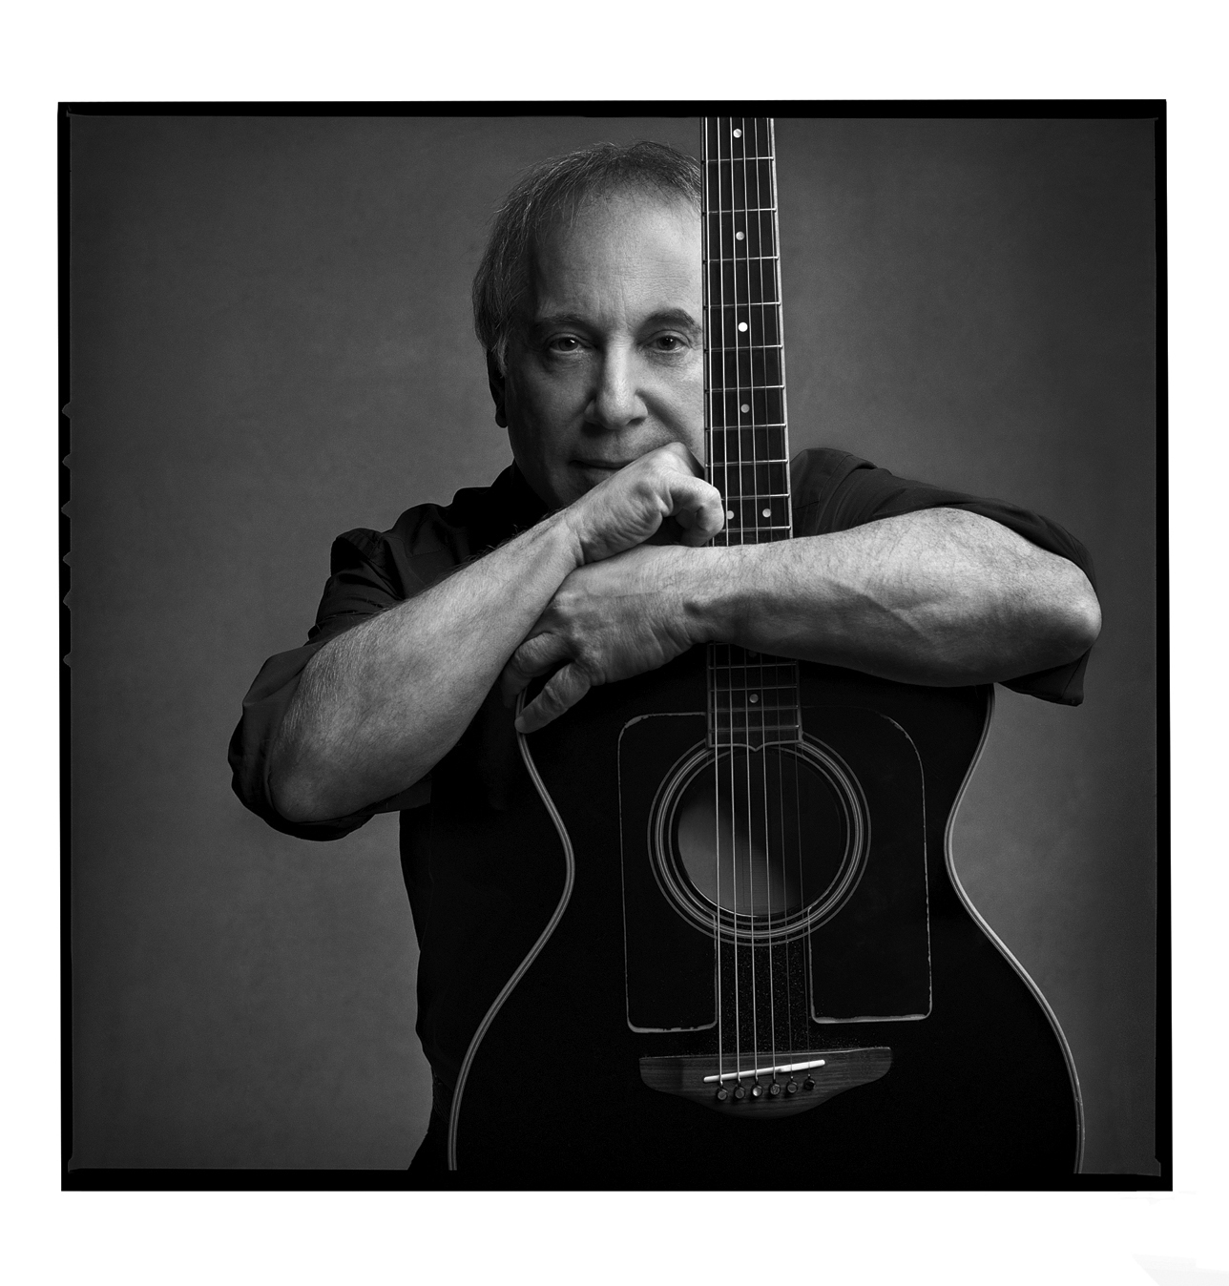
Theme – Culture The composer uses influences of another non-western culture to influence his or her musical style
Pop Music
Diamonds on the Soles of her Shoes
You Can Call Me Al
By Paul Simon
“Diamonds” - South African tribal influence
“Al” - South African pop music influence

Slide 17
Moot – Week 5
Theme – Electronic Music
Music that has been created with or enhanced through the use of electronics

Slide 18
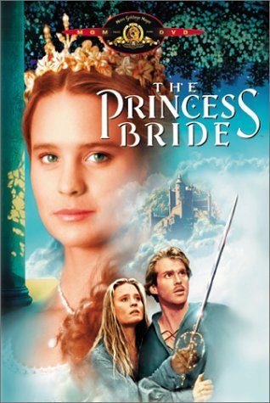
Theme – Electronic Music
Music that has been created with or enhanced through the use of electronics
Soundtrack Music
The Princess Bride Music by Mark Knopfler
Fake orchestra sound

Slide 19
Theme – Electronic Music
Music that has been created with or enhanced through the use of electronics
Art Music
Tromba Marina a Cora
Microstoria_snd
by Nicolas Collins
Backwards Hawaiian guitar and sweeping oscillator

Slide 20
Theme – Electronic Music
Music that has been created with or enhanced through the use of electronics
Pop Music
Go by Moby
Ray of Light and Don’t Tell Me
Madonna
Go
“Techno” music
All electronic with a dance beat
Madonna
Uses electronics to digitally enhance voice to sound electronic

