Slide 1
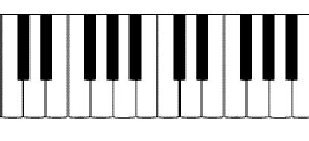
Introduction to the Piano
1. Fill in the Piano keys
C D E F G A B C
2. A sustain pedal allows the notes to ring out even after you lift your fingers from the keys.
3. A chord is when you play three or more notes at the same time.

Slide 2
Introduction Continued…
Chords Spelling Fingering
C Chord C E G 1 3 5
G Chord G B D 1 3 5
F Chord F A C 1 3 5
a Chord a c e 1 3 5

Slide 3
Introduction Continued…
4. A chord progression is when you play a series of chords in a particular order.
5. A beat is a steady pulse. This is where you can manage different tempos.
Melody – a series of pitches played or sung one at a time.
The staff is the 5 lines and 4 spaces on which we write music.
Please draw a Treble Clef
The range of notes on a Treble Clef are D-G

Slide 4
Melody Continued
4. Name the spaces on the staff:
5. The spaces spell F-A-C-E
6. Name the lines on the staff:
7. The phrase to help you remember the lines is “Every Good Boy Does Fine”
8. When you are reading music, you will know to play a chord when three notes are stacked on top of each other.
On the staff, draw a G Major and F Major Chord:

Slide 5
Harmony – more than one note played at the same time.
A ledger line is a line that extends the range of the staff.
Please draw a Bass Clef
The range of notes on a Bass Clef are F-B
Name the spaces on the staff:
“The phrase to help you remember the spaces is “All Cows Eat Grass”
Name the lines on the staff:
The phrase to help you remember the lines is “Great Big Dogs Fight Animals”
When the treble clef and bass clef are written together, it is called the grand staff.

Slide 6
Introduction Continued…
Chords Spelling Fingering
a Chord a c e 1 3 5
This chord is different from the other chords we have learned because it is a MINOR chord.
The difference between a major and minor chord is that a major chord sounds happy ☺ while a minor chord sound sad ☹
On the staff, draw a C Major and an a minor chord:

