Slide 1
Guitar Songs of the Week
8th Grade Guitar Class

Slide 2
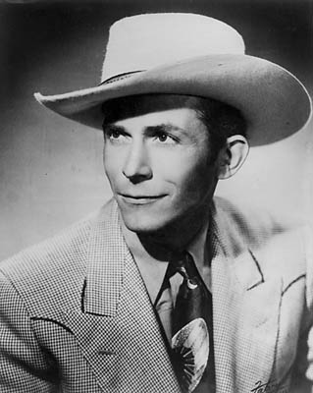
Jambalaya
"Jambalaya (On the Bayou)” Single by Hank Williams from the album Honky Tonkin' (1954). Writer(s) Hank Williams, Moon Mullican (uncredited)
Hank Williams(1923–1953), is an American singer and songwriter and musician who has become an icon of country music and one of the most influential songwriters of the 20th century. A leading pioneer of the honky tonk style, he had numerous hit records. He died at the age of 29.
Hank Williams

Slide 3
“Jambalaya” Chords
Hank Williams

Slide 4
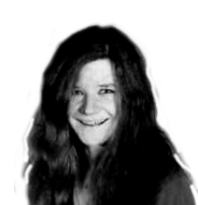
Mercedes Benz
"Mercedes Benz", also known as "The Politician", is an a cappella song sung by Janis Joplin. "Mercedes Benz" together with the poet Michael McClure and Bob Neuwirth, as a critical social commentary on how people relate happiness to money and material possessions. The song was originally written as something of a negative commentary about materialistic individuals who place too much value on items like a Mercedes-Benz.
The song was recorded in one take. "Mercedes Benz were recorded on October 1, 1970, and were the last songs Joplin ever recorded; she died on October 4th. It appeared on the album Pearl (1971). The song title, as listed on that album, contains no hyphen although the automobile brand name is hyphenated.
Janis Joplin

Slide 5
“Mercedes Benz” Chords
Janis Joplin

Slide 6
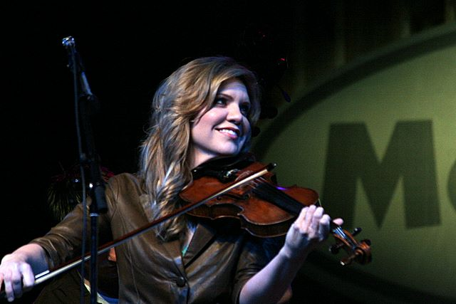
I’ll Fly Away
"I'll Fly Away," written by Albert E. Brumley in 1929, is a hymn most associated with American Baptists and the Church of Christ. It is an optimistic song about an earthly death that leads to everlasting life in glory with Christ.
"I'll Fly Away" has been called the most recorded gospel music song, beginning with a recording by James and Martha Carson, the "Barn Dance Sweethearts" of WSB Atlanta, in 1946, followed two years later by the Chuck Wagon Gang in 1948.
Alison Krauss (born 1971in Decatur, Illinois) is an American bluegrass-country singer and fiddler. She entered the music industry at an early age, winning local contests by the age of ten and recording for the first time at fourteen. She was invited to join the band with which she still performs, Alison Krauss and Union Station (AKUS), and later released her first album with them as a group in 1989.
Her soundtrack performances have led to further popularity, including the Grammy-winning O Brother, Where Art Thou? soundtrack, an album also credited with raising American interest in bluegrass.
Janis Joplin

Slide 7
“I’ll Fly Away” Chords
Alison Krauss

Slide 8
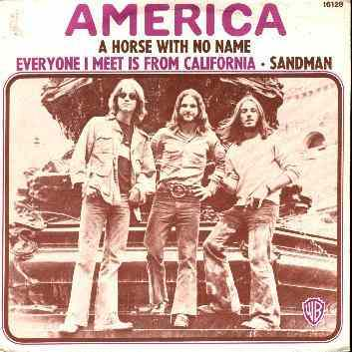
Horse with No Name
"A Horse with No Name" is a song by the band America. It was their first and most successful single, released in early 1972, topping the charts in several countries. It was certified "gold" by the Recording Industry Association of America. America's self-titled debut album was released initially in Europe with only moderate success and without the song "A Horse with No Name". The first two demos were recorded there, by Jeff Dexter and Dennis Elliott, and was intended to capture the feel of the hot, dry desert, that had been depicted at the studio from Salvador Dalí painting, and the strange horse had ridden out of an M.C. Escher picture. Writer Dewey Bunnell also says he remembered his childhood travels through the Arizona and New Mexico desert when his family lived at Vandenberg Air Force Base.
America is an English-American folk rock musical band, composed originally of members Gerry Beckley, Dewey Bunnell, and Dan Peek. The three members were barely past their teenage years when they became a musical sensation during 1972, with their main popularity during the early to mid 1970s and early 1980s.
America

Slide 9
“Horse With No Name” Chords
America

Slide 10
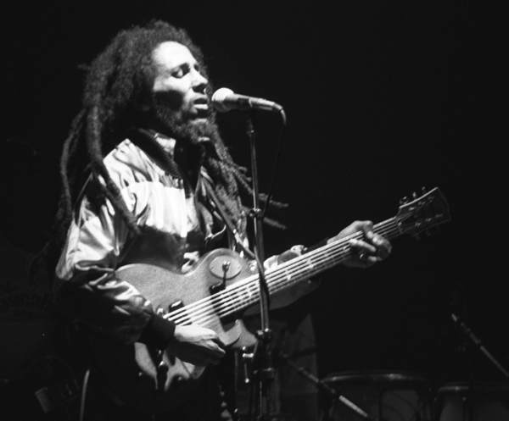
Don’t Worry about a Thing/One Love
"Three Little Birds” (Don’t Worry about a Thing) is a song by Bob Marley & The Wailers from their 1977 album Exodus. It is one of Bob Marley's most popular songs. The single was released in 1980 and reached the Top 20 in the UK, peaking at number 17. The song has been covered by numerous other artists. whose version reached number one on the Billboard Hot Singles Sales chart in 2008.
"One Love” is a reggae/Rhythm and blues song by Bob Marley & The Wailers from their 1977 album Exodus. It was first recorded in a ska style by Marley's original group, The Wailers, on their 1965 debut album The Wailing Wailers. It has also been included on many of their compilation albums, making it an influential classic.
Robert Nesta "Bob" Marley (1945 – 1981) was a Jamaican singer-songwriter and musician. He was the lead singer, songwriter and guitarist for the ska, rocksteady and reggae bands The Wailers (1964–1974) and Bob Marley & The Wailers (1974–1981). Marley remains the most widely known and revered performer of reggae music, and is credited for helping spread both Jamaican music and the Rastafari movement to a worldwide audience.
Bob Marley

Slide 11
Don’t Worry About a Thing/One Love
Bob Marley

Slide 12
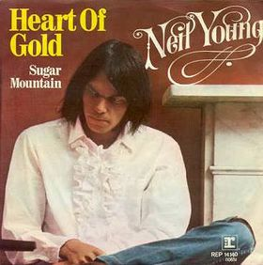
Heart of Gold
"Heart of Gold" from the 1972 album Harvest is Neil Young's only number one hit single in his long musical career. Rolling Stone ranked it #297 on their list of the 500 greatest songs of all time. It features the back-up vocals of James Taylor and Linda Ronstadt. Unable to stand for long periods of time, he could not play his electric guitar and so returned to his acoustic guitar, which he could play sitting down.
Neil Young (born 1945) is a Grammy Award winning Canadian singer-songwriter, musician and film director. He was inducted into the Rock and Roll Hall of Fame as a solo artist in 1995 and also as a member of Buffalo Springfield in 1997. He established himself as the tentative fourth member of Crosby, Stills & Nash. He has since become "one of the most respected and influential musicians of his generation”.
Neil Young

Slide 13
Heart of Gold
Neil Young

Slide 14
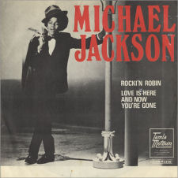
Rockin’ Robin
"Rockin' Robin" is a song written by Leon René under the pseudonym Jimmie Thomas and recorded by Bobby Day in 1958. It was Day's only hit single, becoming a No. 2 Billboard Hot 100 hit.
Michael Jackson (1958 – 2009) was an American singer, dancer and entertainer. Referred to as the King of Pop, he is the most successful entertainer of all time, and one of the most influential. His contributions to music, dance and fashion, and a much publicized personal life, made him a global figure in popular culture for over four decades. Jackson recorded and released a cover version of "Rockin' Robin" in 1972, which was taken from his 1971 first solo album titled "Got to Be There". It was the biggest hit from the album, peaking at #2 on the Pop Charts and Black Singles Charts
Michael Jackson

Slide 15
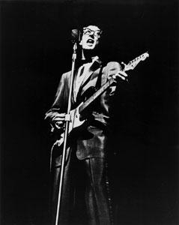
Oh Boy
"Oh Boy!" is a song originally performed by Buddy Holly's band The Crickets. It was written by Sonny West and Bill Tilghman; the band's manager Norman Petty added his name as co-composer. The song was recorded June 29 - July 1, 1957 at Petty Studios in Clovis, New Mexico, with Holly singing lead vocals and The Picks providing backing vocals. The song in an A-A-B-A format with a 12-bar blues verse and an 8-bar bridge.
Buddy Holly(1936 – 1959), was an American singer-songwriter and a pioneer of rock and roll. Although his success lasted only a year and a half before his death in an airplane crash, Holly is described by critic Bruce Eder as "the single most influential creative force in early rock and roll.”[ His works and innovations inspired and influenced both his contemporaries and later musicians, notably The Beatles, The Beach Boys, The Rolling Stones, Don McLean, and Bob Dylan, and exerted a profound influence on popular music.
Buddy Holly

Slide 16
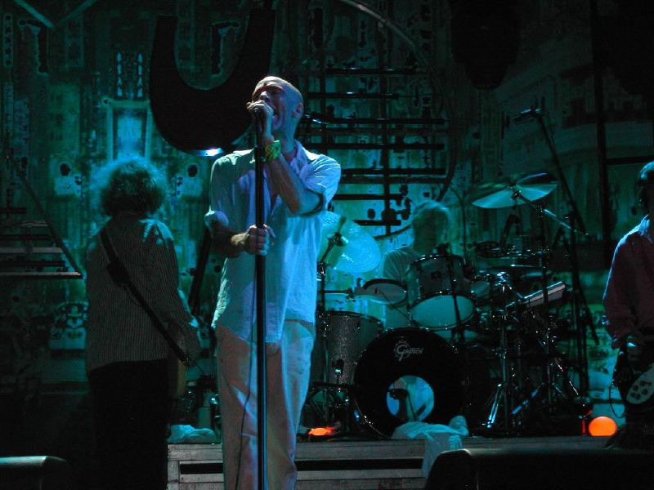
One I Love
"The One I Love" is a song by American rock band R.E.M. It was released on the band's fifth full-length studio album, Document in 1987. The song was their first hit single, reaching #9 in the US Billboard Hot 100, #14 in Canada, and later reached #16 in the UK singles chart on its UK release (1991).
R.E.M. is an American rock band formed in Athens, Georgia in 1980 by Michael Stipe (lead vocals), Peter Buck (guitar), Mike Mills (bass guitar), and Bill Berry (drums and percussion). R.E.M. was one of the first popular alternative rock bands.
R. E. M.

Slide 17
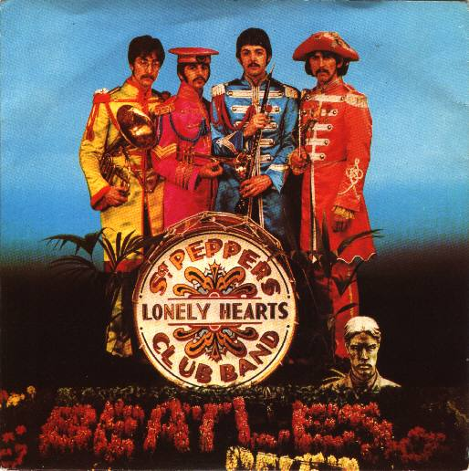
With a Little Help From My Friends
"With a Little Help from My Friends” is a song written by John Lennon and Paul McCartney, released on The Beatles album Sgt. Pepper's Lonely Hearts Club Band in 1967. The song was written for and sung by Beatles drummer Ringo Starr as the character "Billy Shears"; it is ranked #304 on Rolling Stone's list of the 500 Greatest Songs of All Time.
The Beatles produced what critics consider their finest material, the album Sgt. Pepper's Lonely Hearts Club Band (1967), widely regarded as a masterpiece. Nearly four decades after their breakup, The Beatles' music continues to be popular. The Beatles have had more number one albums on the UK charts, and held down the top spot longer, than any other musical act. They have sold more albums in the US than any other artist. They have been honored with 7 Grammy Awards, and they have received 15 Ivor Novello Awards from the British Academy of Songwriters, Composers and Authors. The Beatles were collectively included in Time magazine's compilation of the 20th century's 100 most important and influential people.
Beatles

Slide 18
“With A Little Help From My Friends” Chords
The Beatles

